Slide 1

Recruitment Management
By,
Anwar Hossain
EMP Id: 11267
29th Oct, 2021
Image Placeholder
Notes:
<number>

Slide 2
ABOUT THE PROJECT
Project Objectives: This website/application will serve as a recruit management application. One organization or person will be managed all the recruitment step easily by using it. Organization can manage their training period for fresh employee or track their activity by using this web application.
Project Context: The purpose of this project is to develop a valuable web application to manage BJIT recruitment policy efficiently.

Slide 3
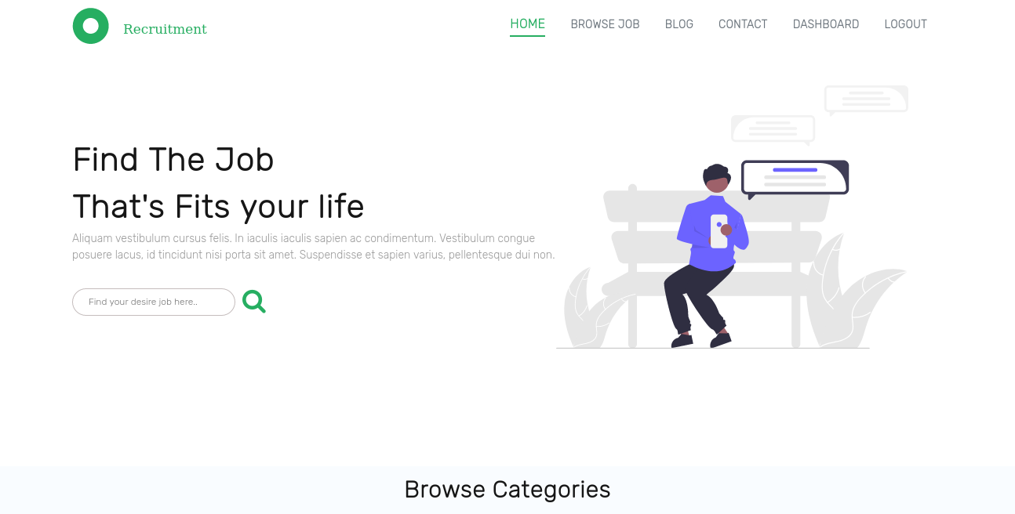
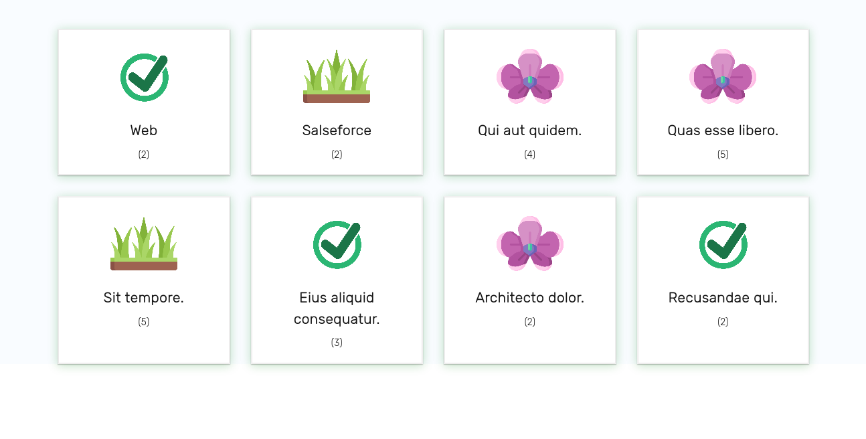
Project Feature
Home Page : contains navbar with nav links, category wise jobs, featured jobs also latest job section, Footer which contains subscribe button , Address & some links.

Slide 4
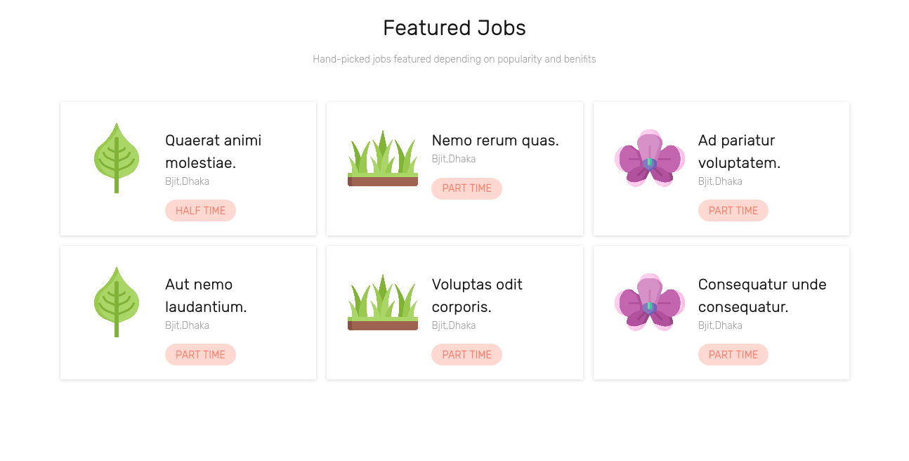
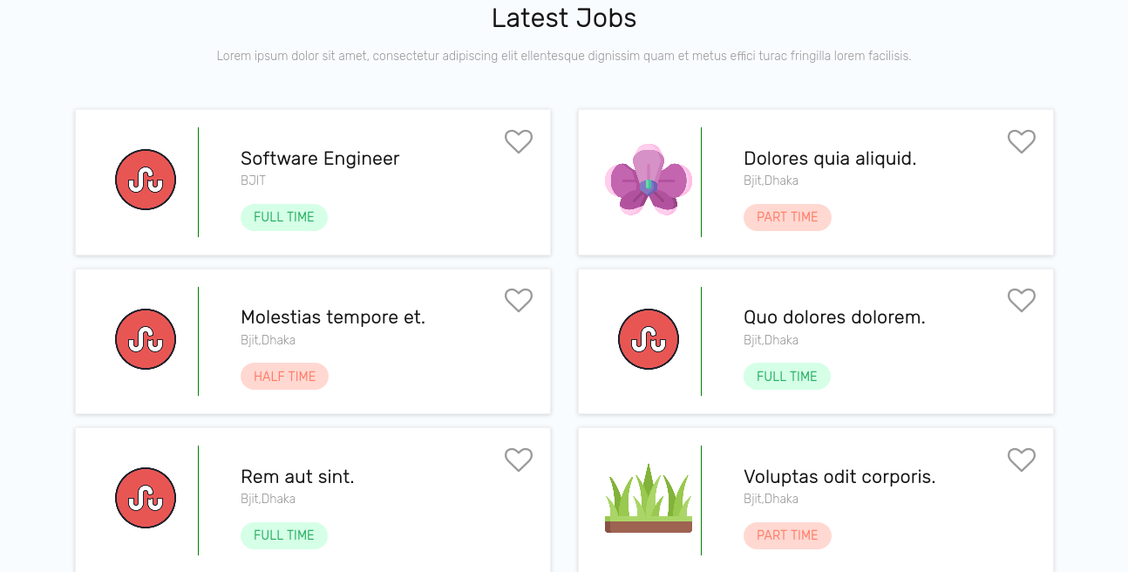
Project Feature
Home Page : contains navbar with nav links, category wise jobs, featured jobs also latest job section, Footer which contains subscribe button , Address & some links.

Slide 5
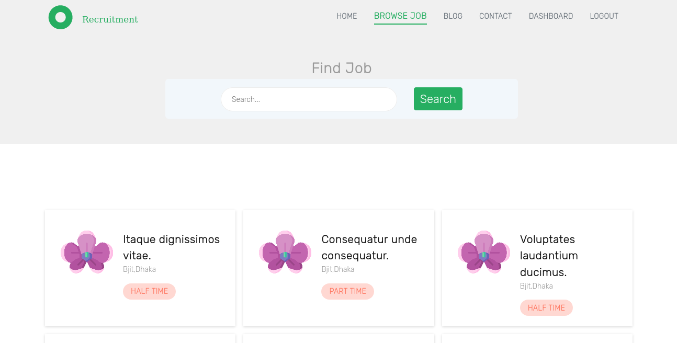
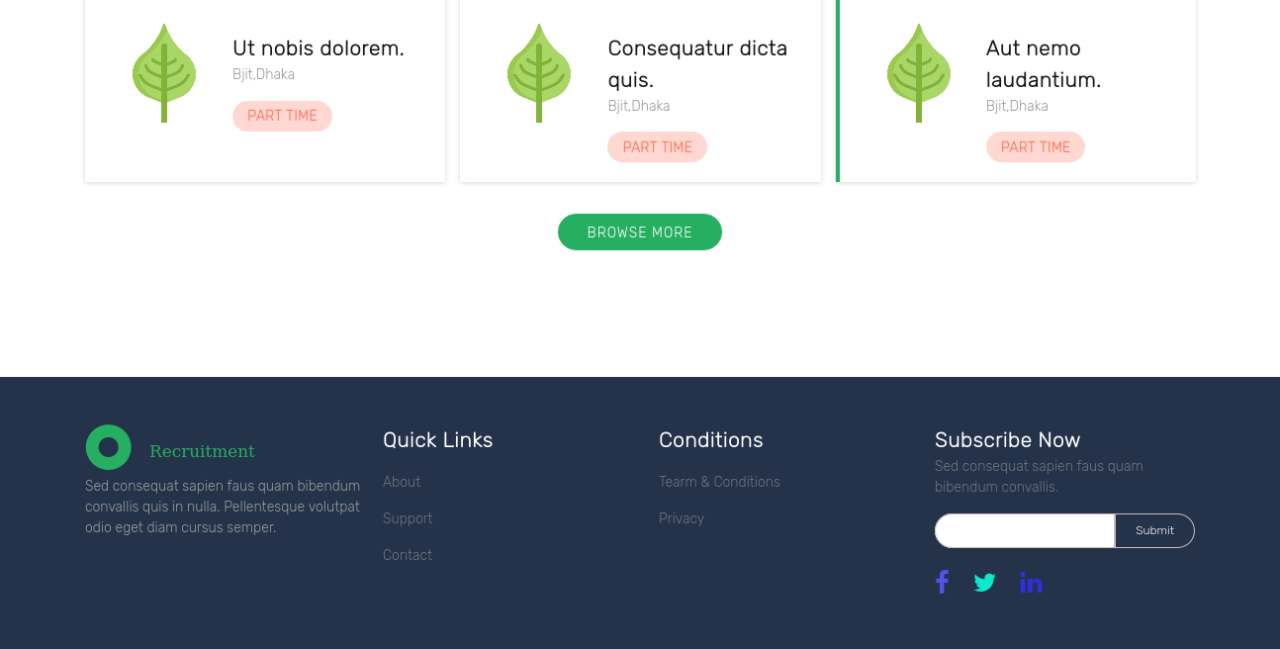
Project Feature
Browse Job: Showing all active jobs with search buttion with images.
- Also showing show more button to fetching active jobs with search buttion with image.
- Also showing show more button to fetching ore jobs dynamically
Subscribe : In footer, a subscribe form for subscription to get notify job posts.

Slide 6
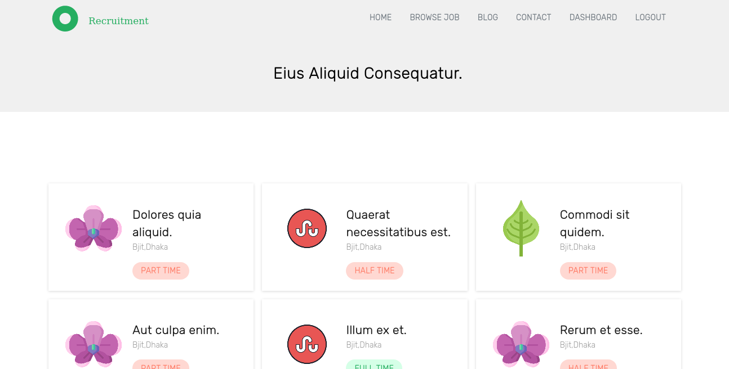
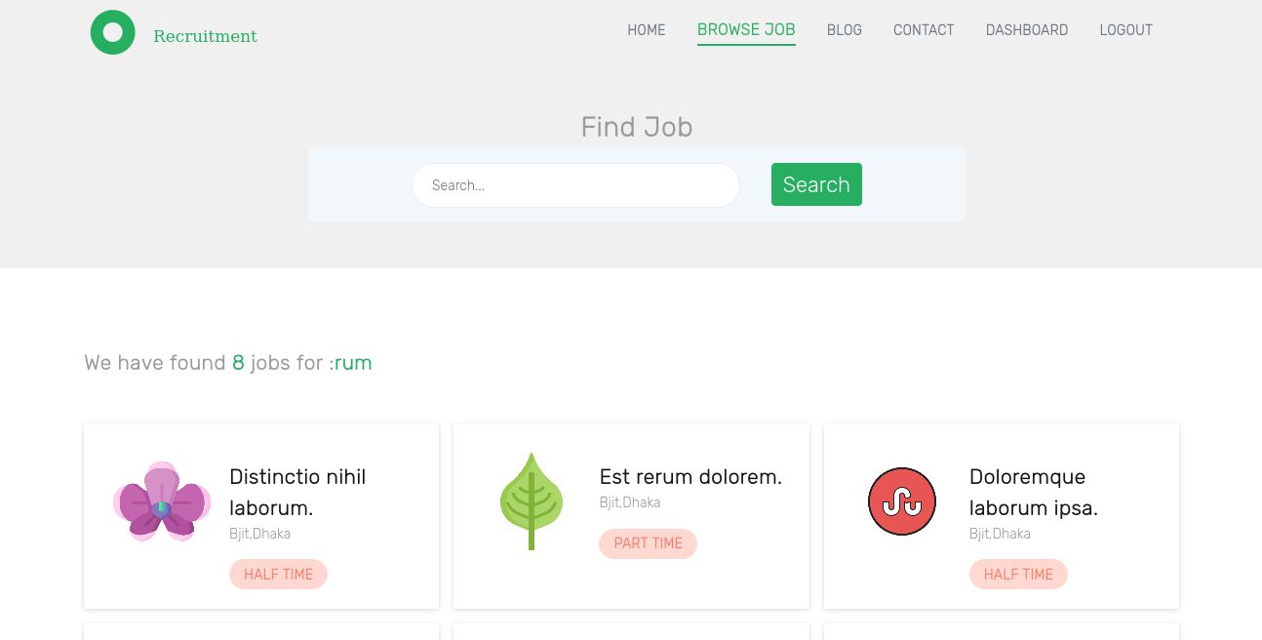
Project Feature
Job By Category: Showing all active jobs By Category.
Search Job : Showing all searched job with number

Slide 7
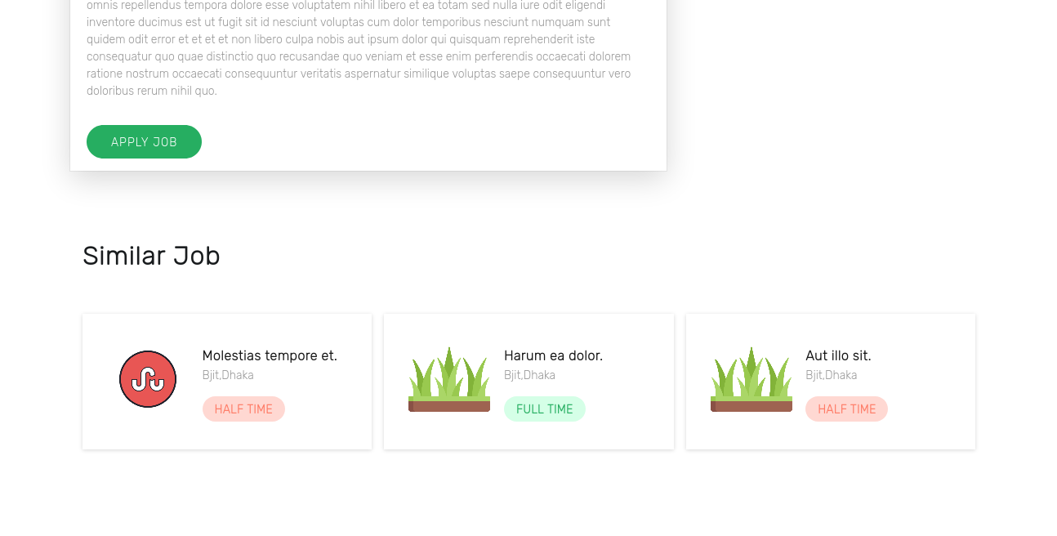
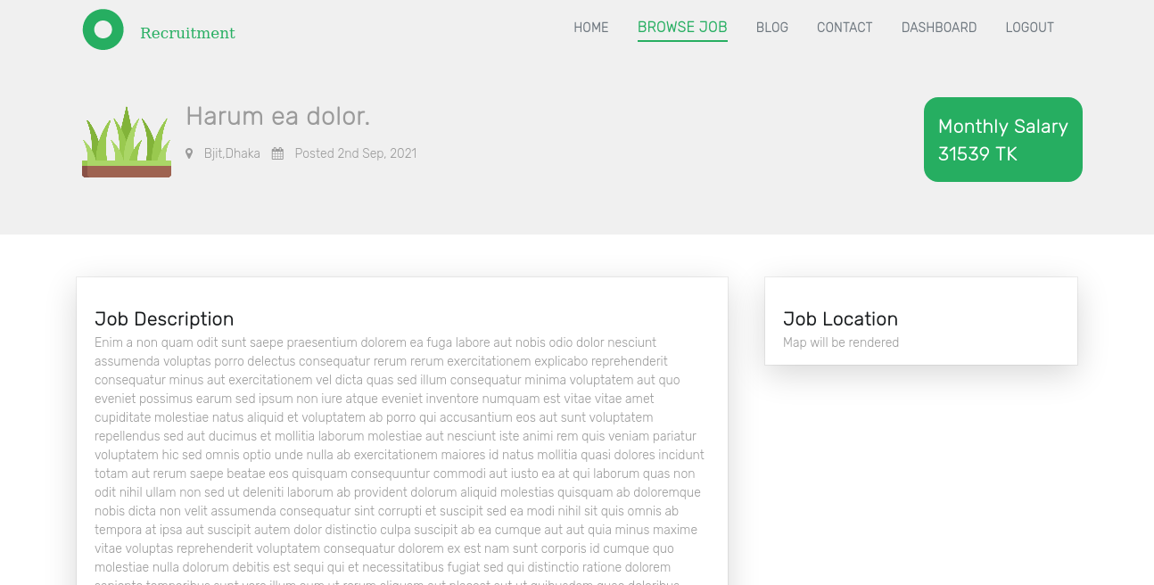
Project Feature
Job Details: Showing specific active job By slug.
Also showing random 3 jobs at the bottom under this category

Slide 8
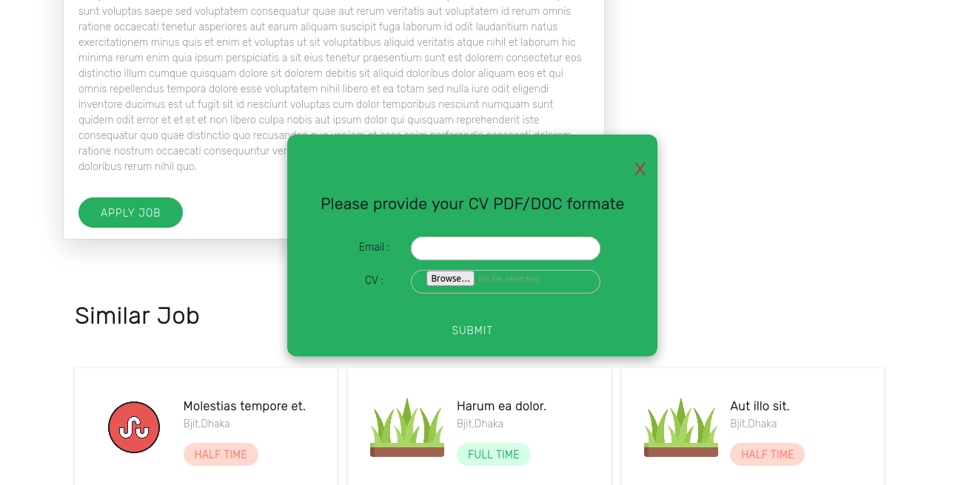
Project Feature
Apply Job: Apply Job modal to apply specific job

Slide 9
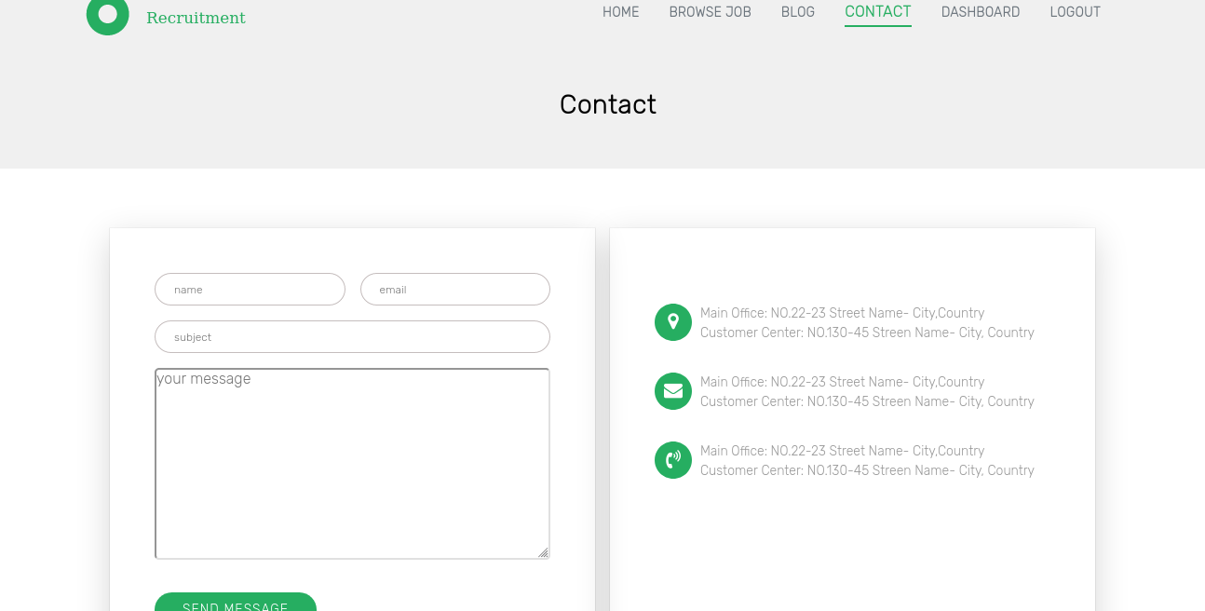
Project Feature
Contact :
- Contain contact form and info of BJIT.
- Any one can contact with management

Slide 10
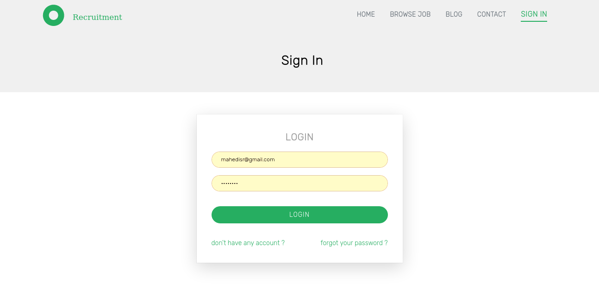
Project Feature
Contact :
- Any user can authenticate with their valid credentials

Slide 11
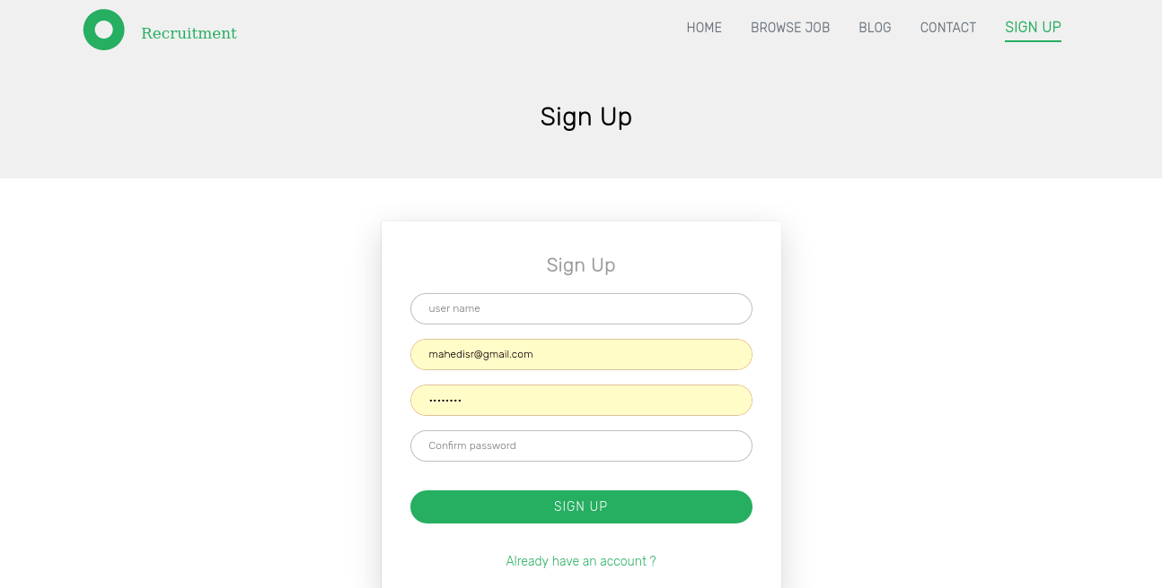
Project Feature
Authentication:

Slide 12
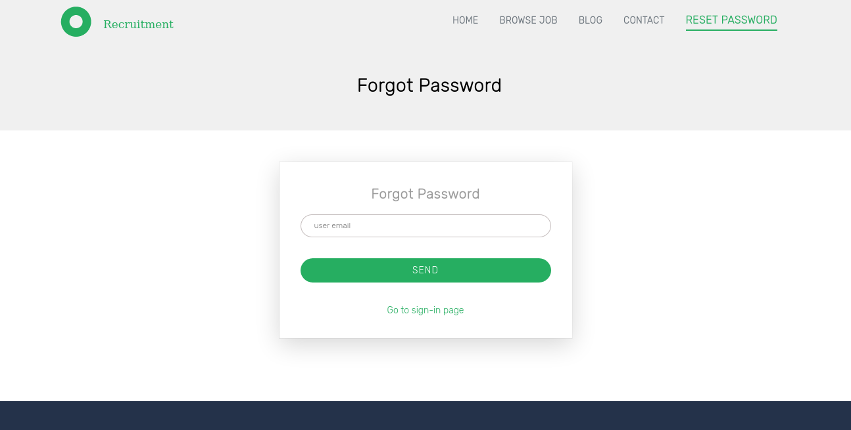
Project Feature
Authentication:

Slide 13
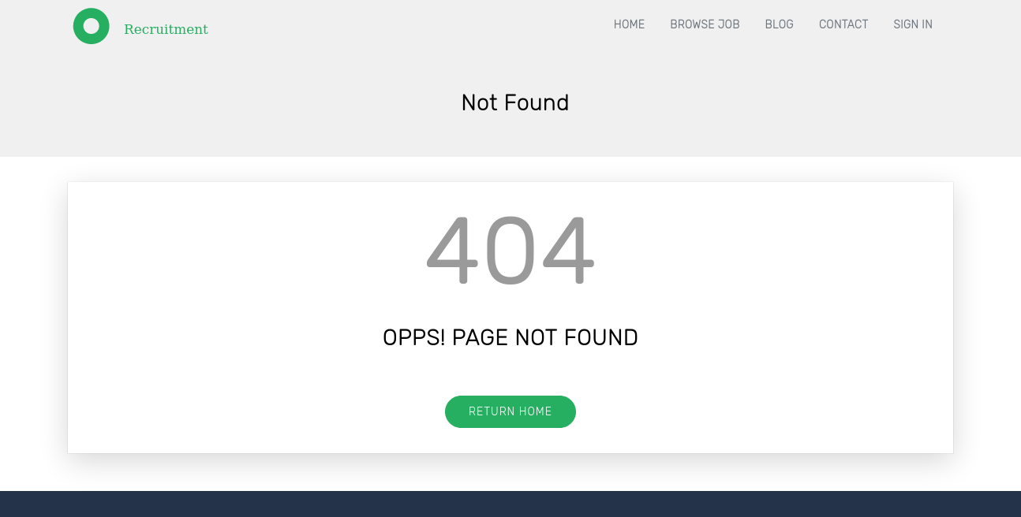
Project Feature
404:

Slide 14
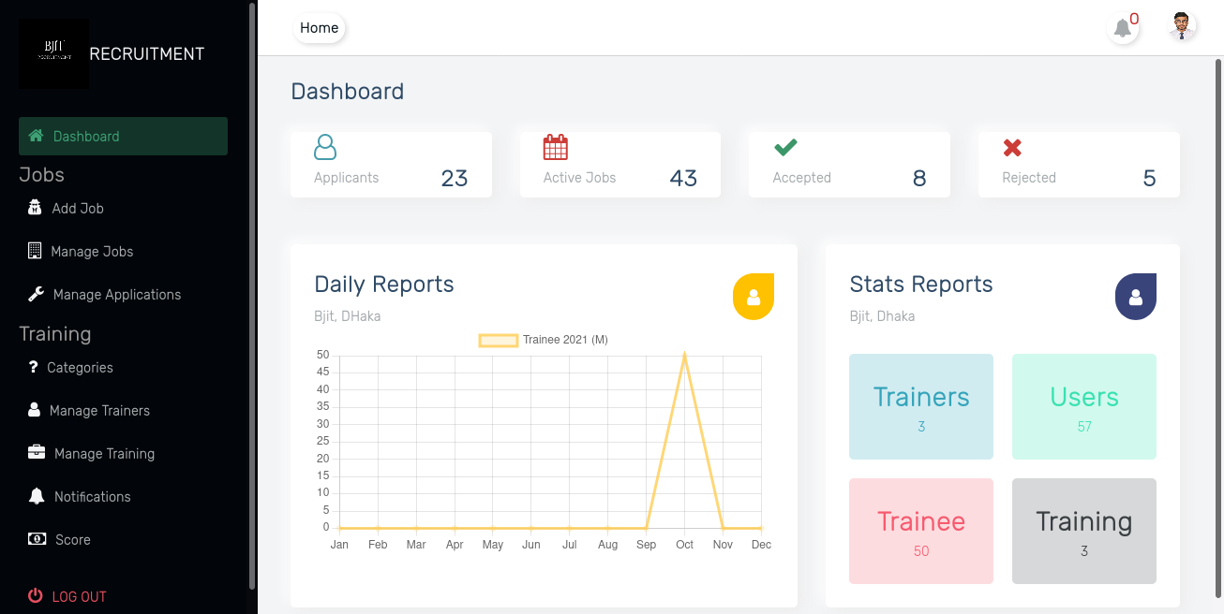

Project Feature Admin
Dashboard:
-showing statistical data
-Data represents

Slide 15
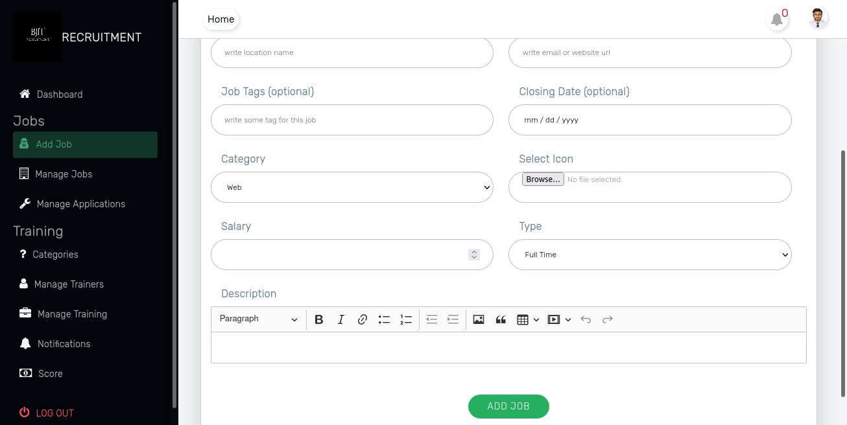
Project Feature Admin
Job Feature:

Slide 16
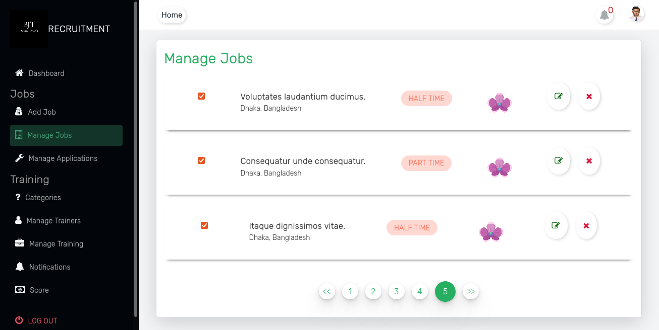
Project Feature Admin
Job manage:
-Can be manage all jobs with CRUD operation
-CRUD operation on JOB with pagination
[ create,read,update,delete ]

Slide 17
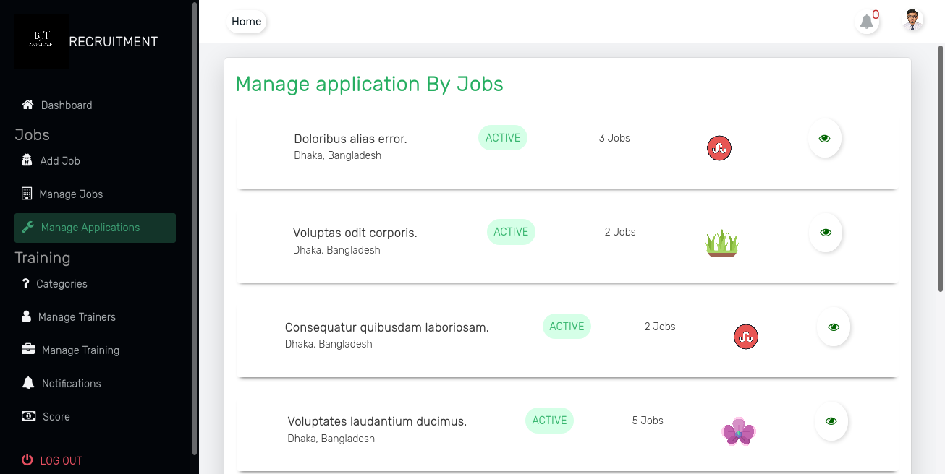
Project Feature Admin
Manage Application :
-All Application by category (job)
-showing data with pagination

Slide 18
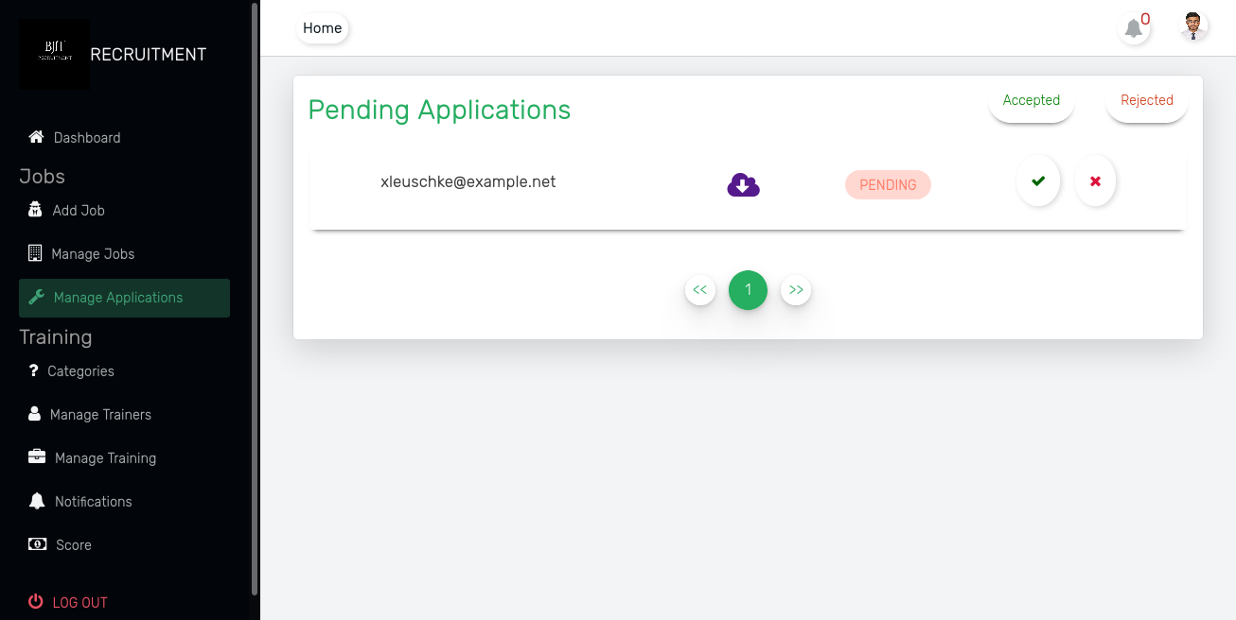
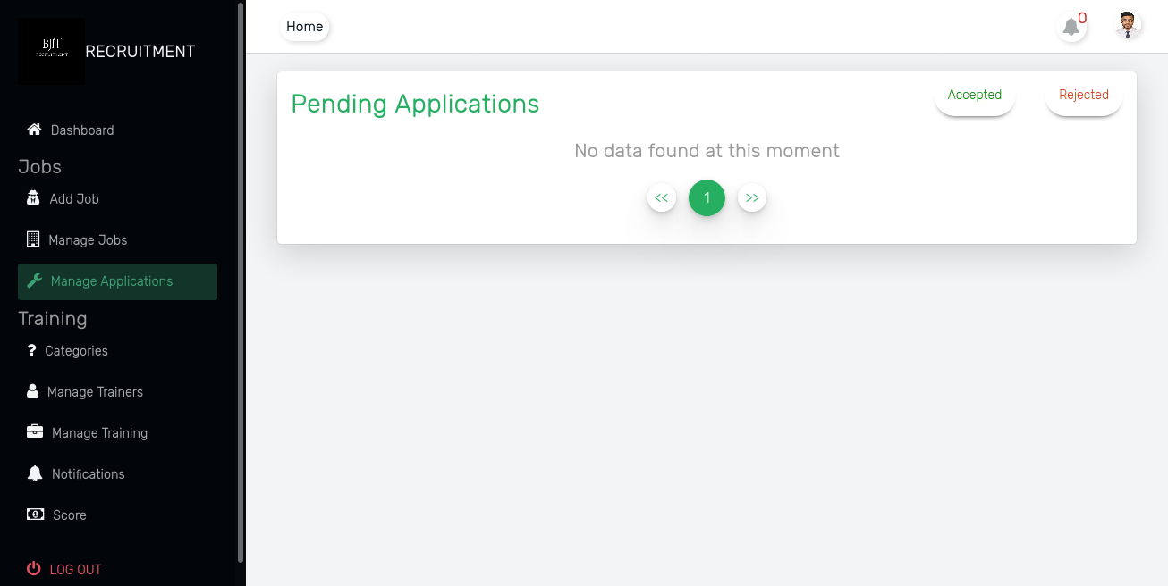
Project Feature Admin
Application manage:
- showing all pending Application with users CV.
- update state pending to accept or reject

Slide 19
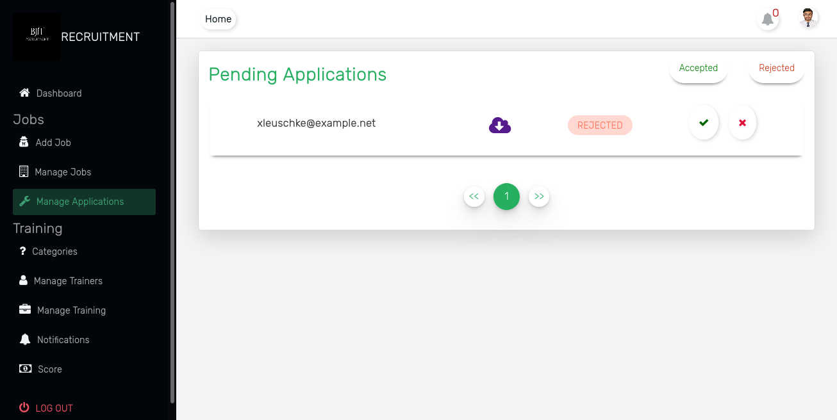
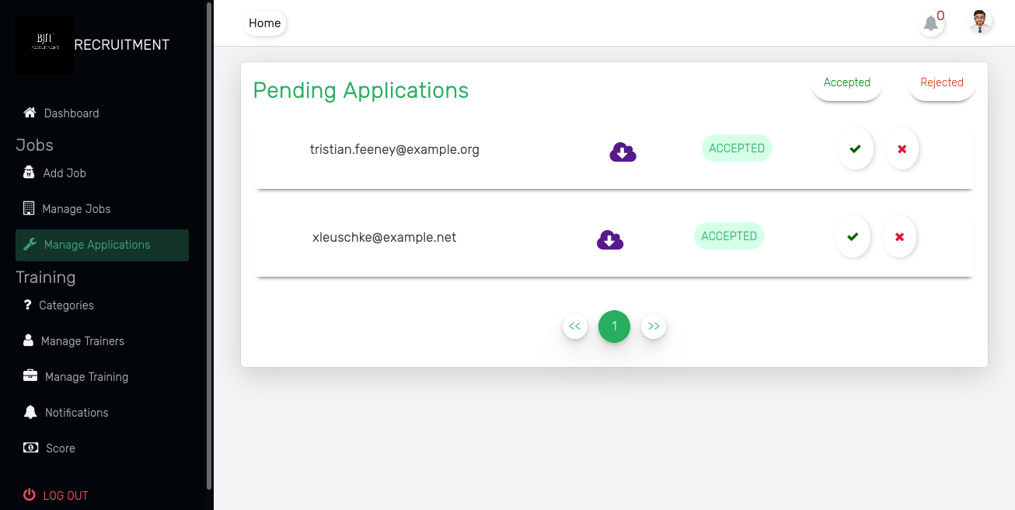
Project Feature Admin
Application manage:
- showing all accepted Application with users CV.
- update state accept to reject or pending
- delete from rejected list or accept again

Slide 20
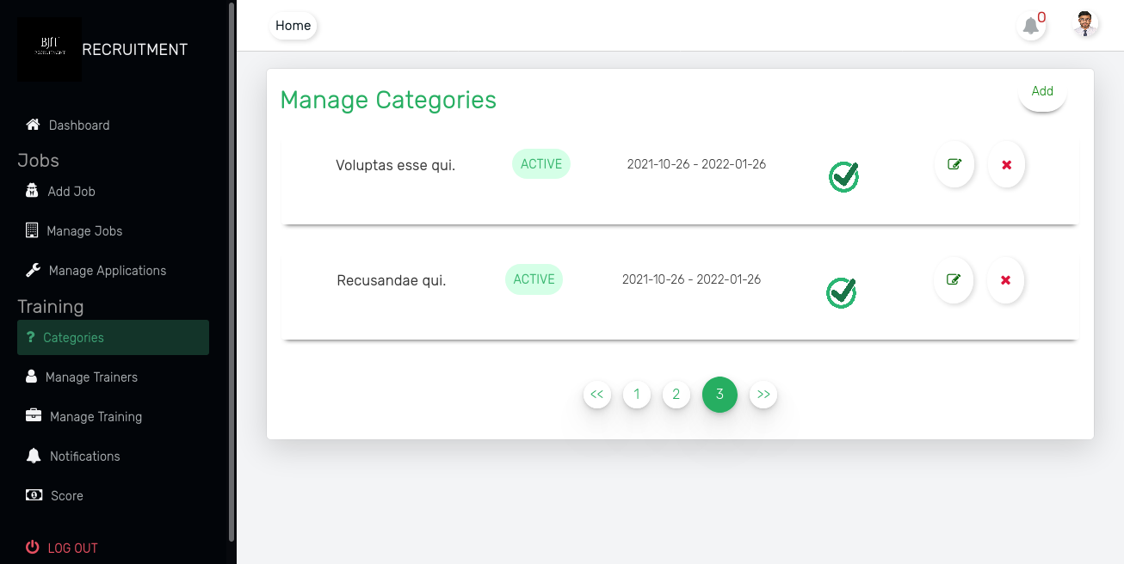
Project Feature Admin
Job Category manage:
- Showing all jobs with pagination.
-Delete any category with other relational table (cascade)
-Crud operation on Job Category

Slide 21
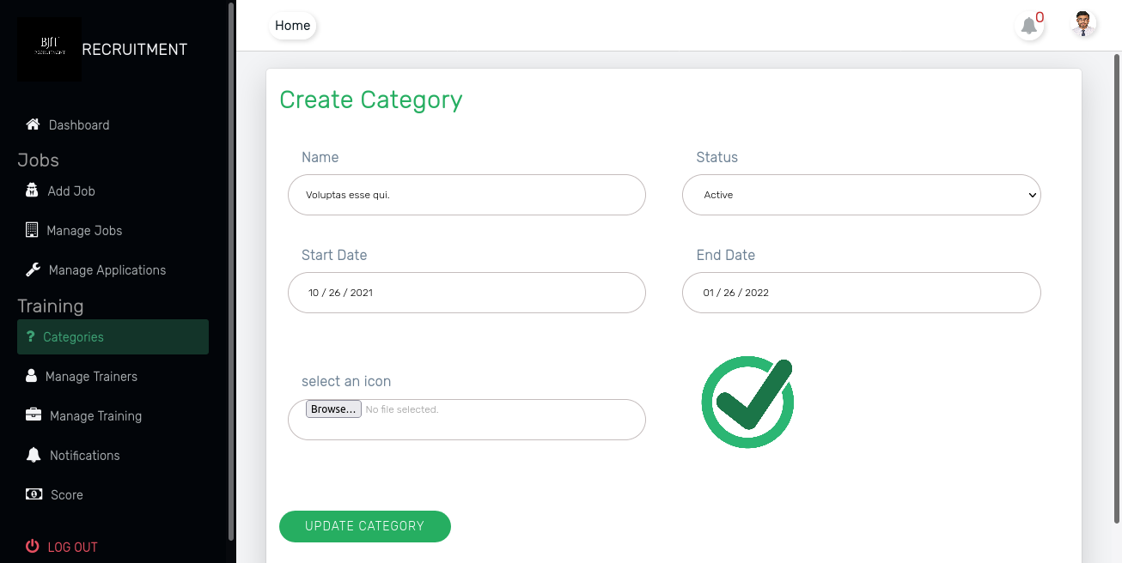
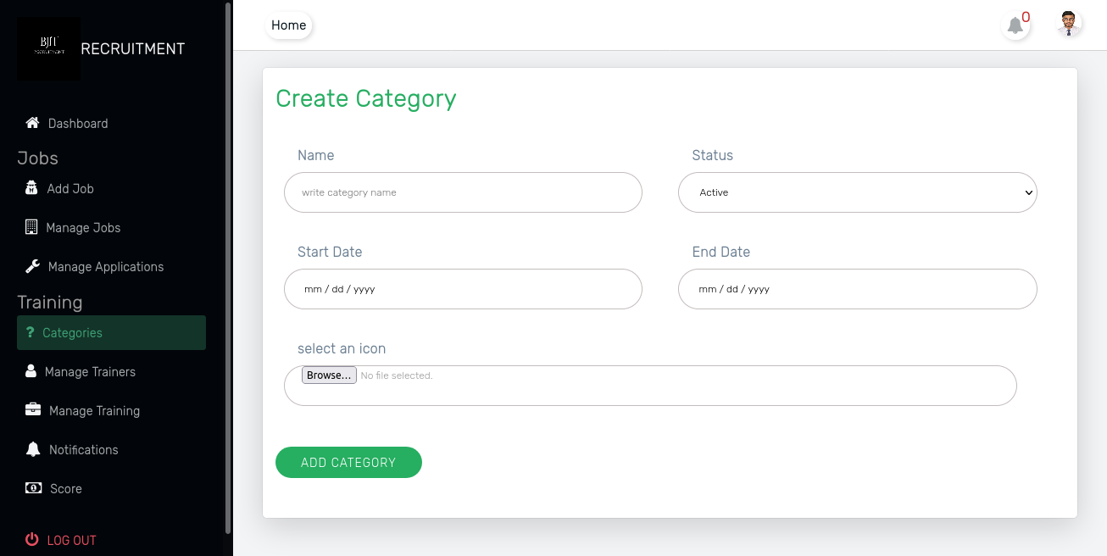
Project Feature Admin
Job Category manage:
- Add New Category for job and Training.
-Update Category for job and Training.

Slide 22
Project Feature Admin
Job Category manage:
- Add New Category for job and Training.
-Update Category for job and Training.

Slide 23
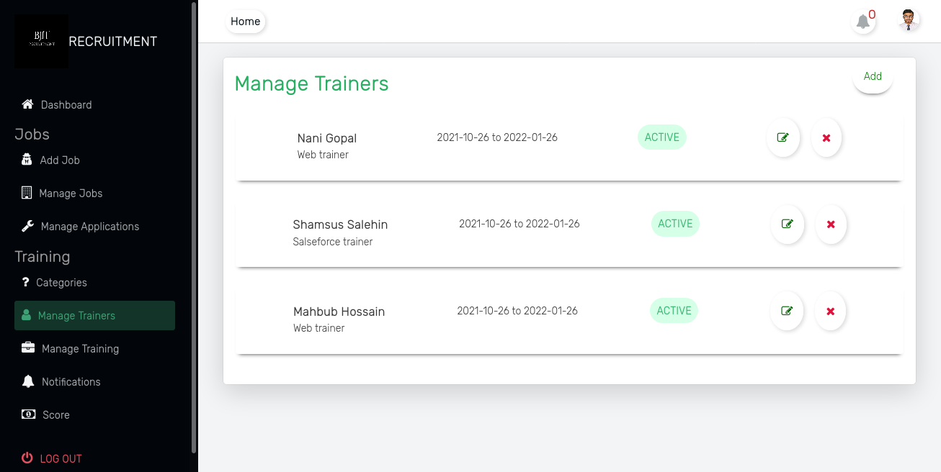
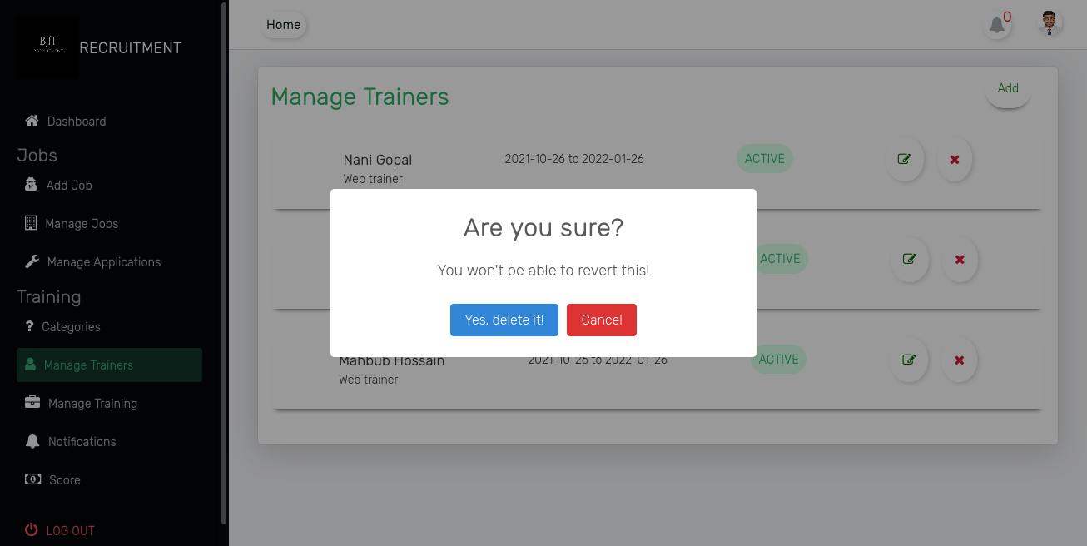
Project Feature Admin
Trainers manage:
- Manage trainers for individual training
-Delete any trainer
-Crud Operation on Trainer Table

Slide 24
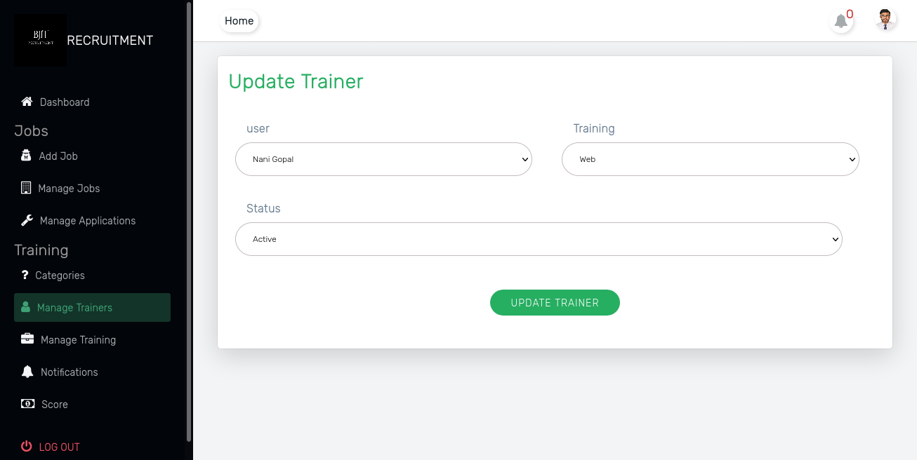
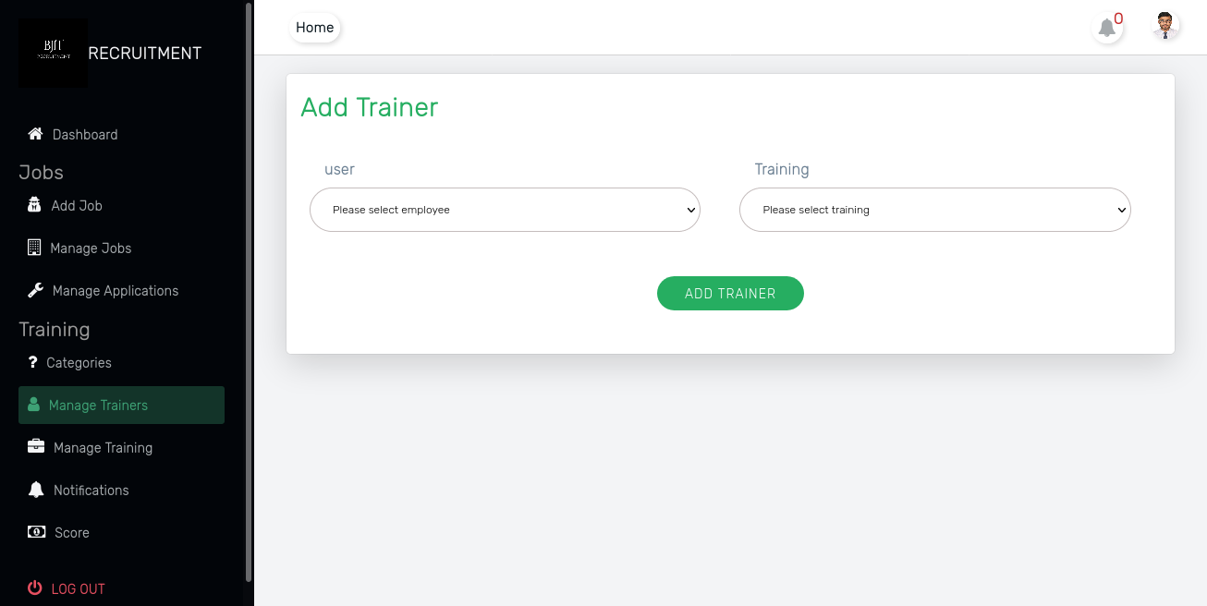
Project Feature Admin
Trainers manage:
- Add and update any trainer
-Crud Operation on Trainer Table

Slide 25
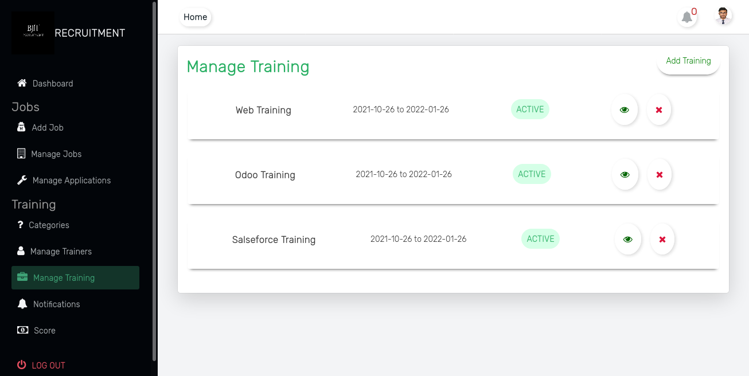
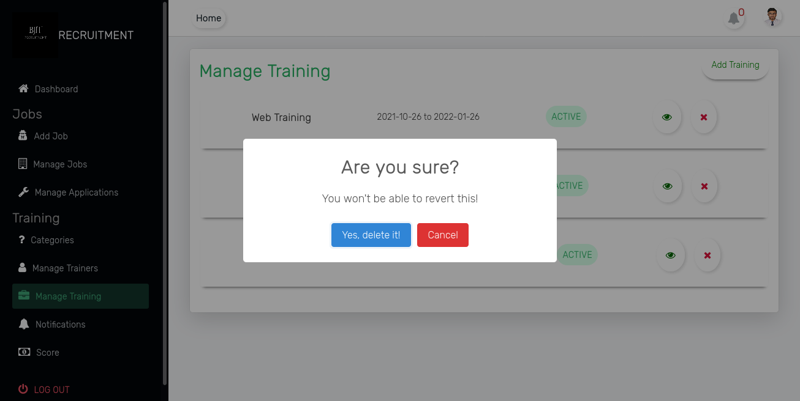
Project Feature Admin
Training manage:
- View , delete any training or job category with all relational table
-Crud Operation on Training Table

Slide 26
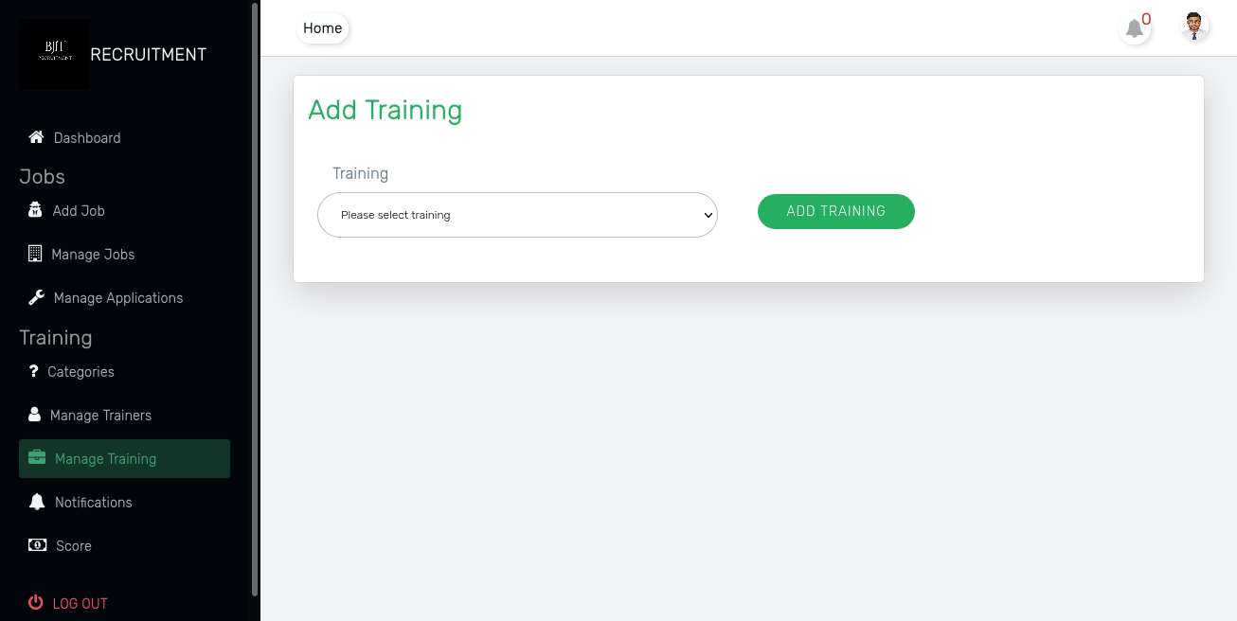
Project Feature Admin
Training manage:
- Add new training with category name
-Crud Operation on Training Table

Slide 27
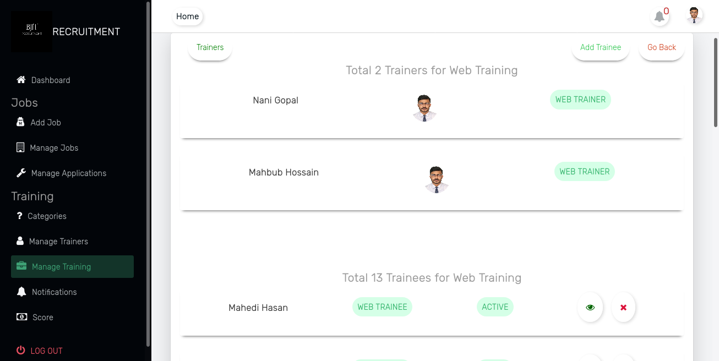
Project Feature Admin
Trainee manage:
- showing all trainee and trainers for individual training
-Delete any trainee from training
-View any trainee info
-Crud Operation on trainee Table

Slide 28
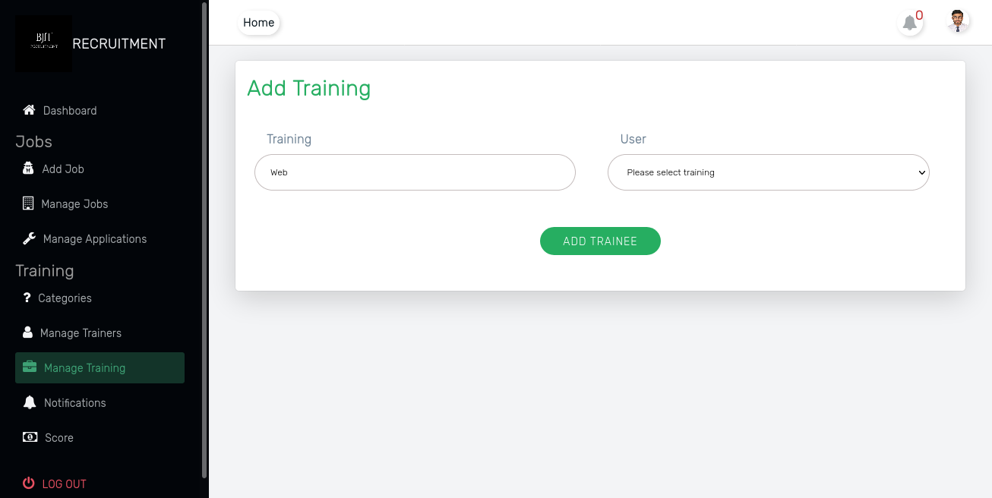
Project Feature Admin
Trainee manage:
- Add new trainee in specific training
-Crud Operation on trainee Table

Slide 29
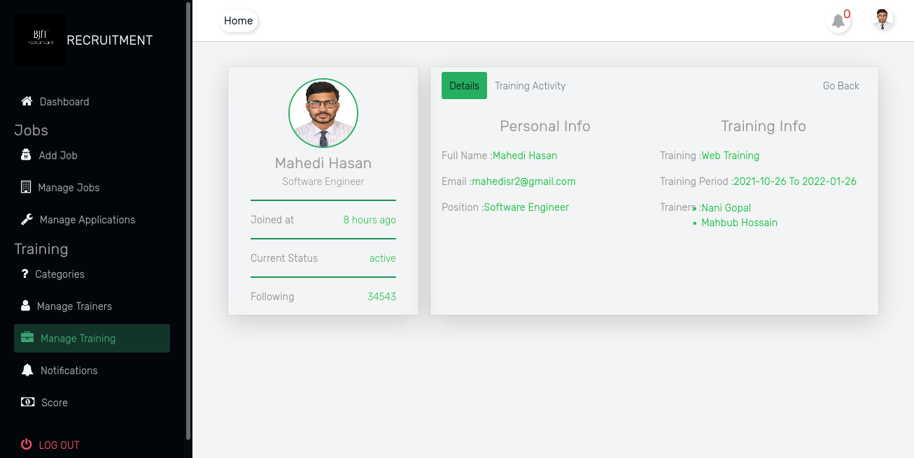
Project Feature Admin
Trainee manage:
- Details of a trainee info in details tab
-Crud Operation on trainee Table

Slide 30
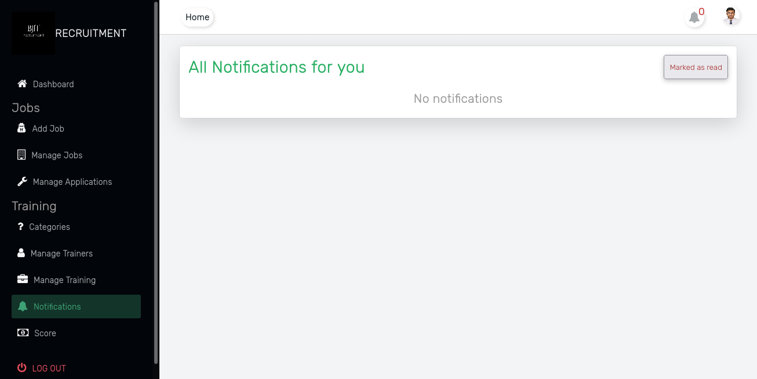
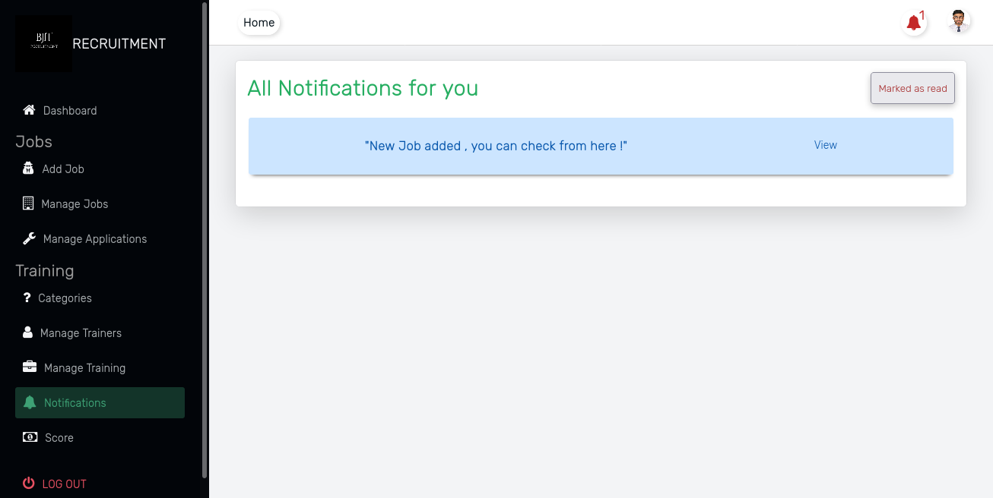
Project Feature Admin
Real Time Notification:
- All notification manage with dynamic links for admin
Read all notification to clear all

Slide 31
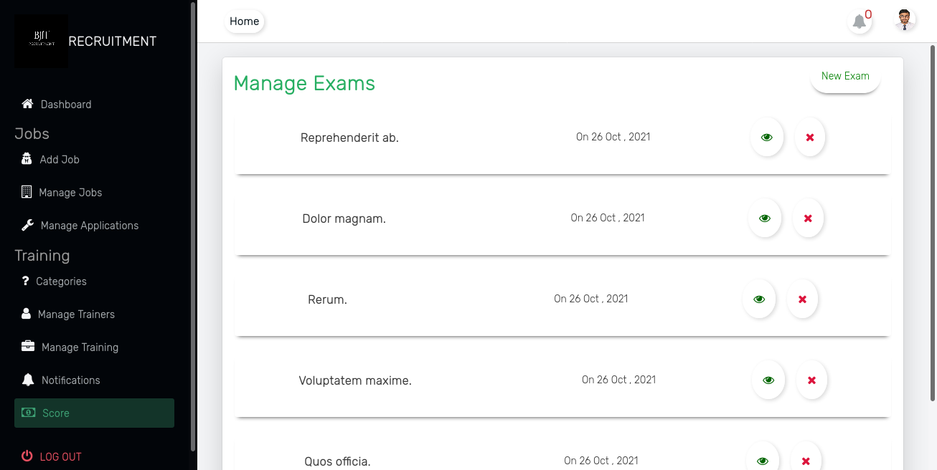
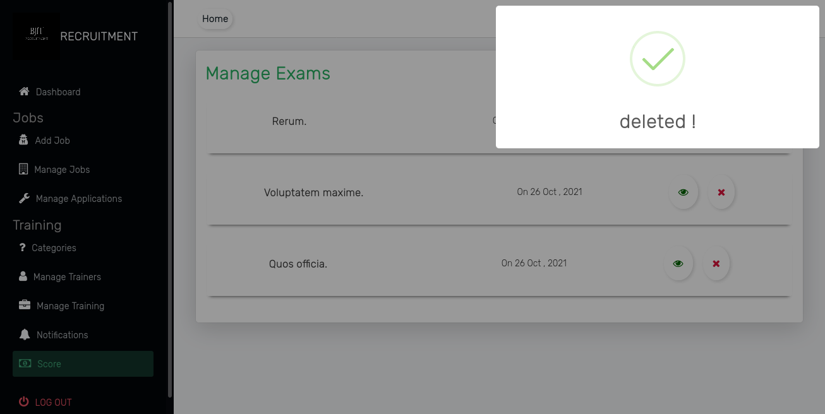
Project Feature Admin
Manage Exams:
- Manage Exams and Score
Showing all exam
Delete any Exam with all scores
CRUD operation on Exam Table

Slide 32
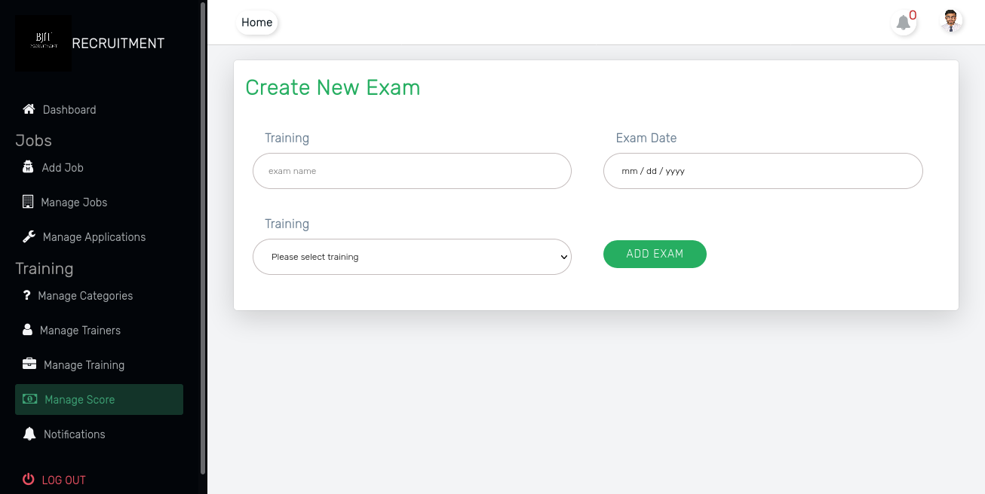
Project Feature Admin
Manage Exams:
- Add new exams for trainee

Slide 33
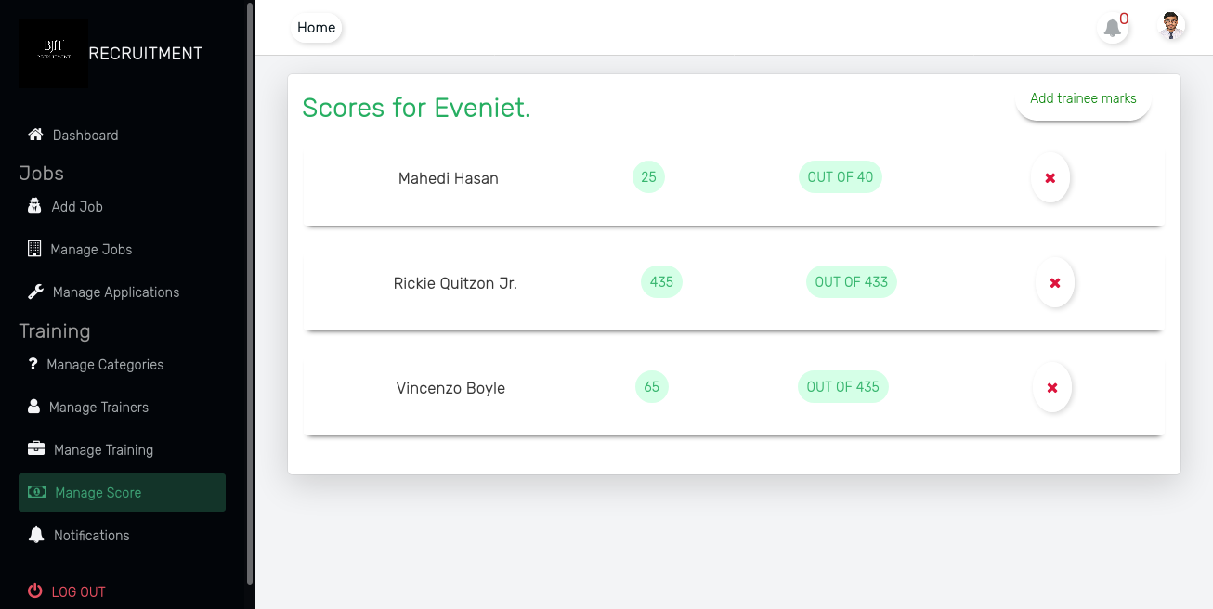
Project Feature Admin
Manage Exams:
- Manage Score for a specific exam for all trainee
Delete any trainee exam marks

Slide 34
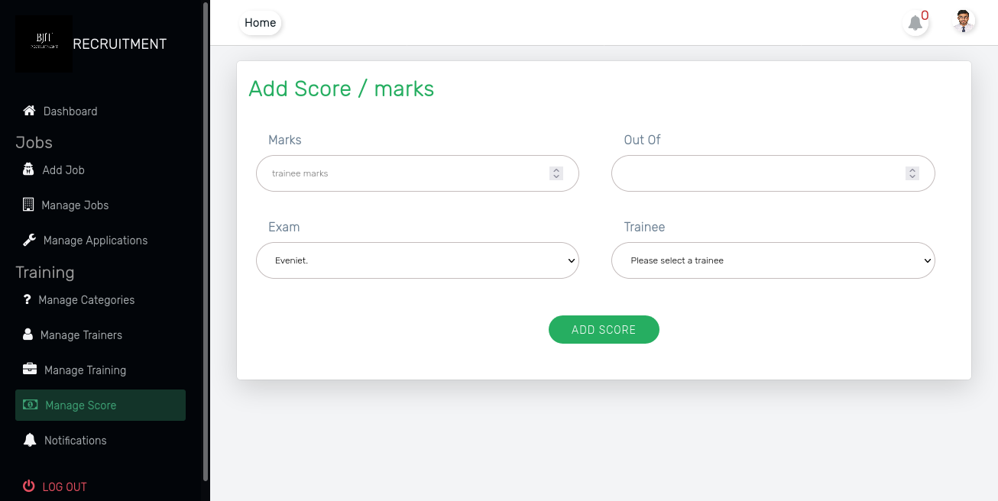
Project Feature Admin
Manage Scores:
- Add specific Exam score/marks dynamically add for individual trainee

Slide 35
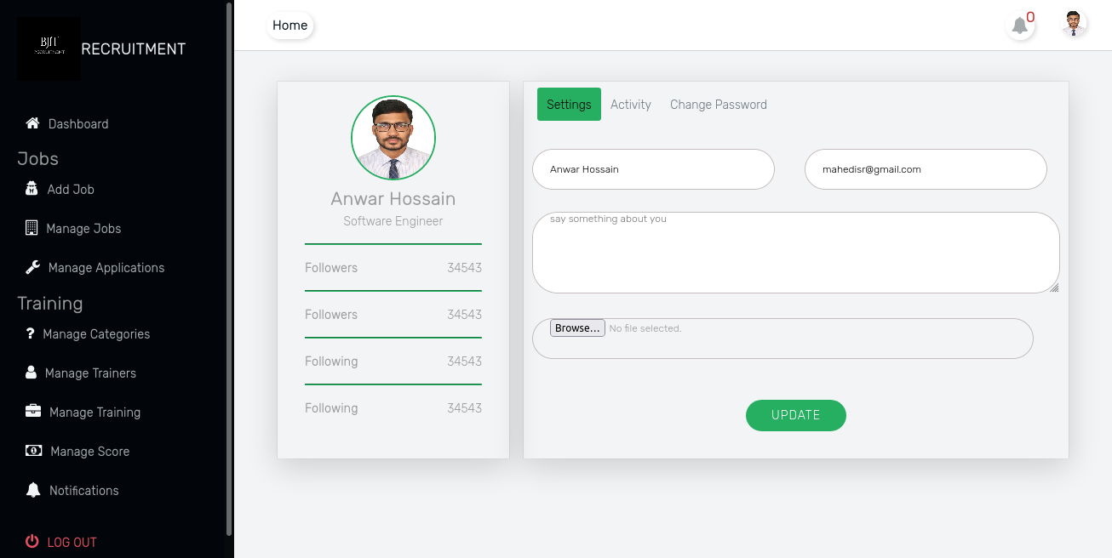
Project Feature Admin
Manage Profile:
- update self info

Slide 36
Thank You!!

